Slide 1
Mobile Application for Intraoperative Naming Test for National Languages of Russia
Faculty of Computer Science &
Center for Language and Brain
Department of
Software Engineering
Moscow
2023
Zubareva Nataliia
BSE195

Slide 2
Outline
Faculty of Computer Science &
Center for Language and Brain
Department of
Software Engineering
Moscow
2023
Terminology
Introduction
Problem and solution research
Proposed solution
Goals and methodology
Technological stack
Current stage
Expected results and conclusion
References

Slide 3
Terminology
Faculty of Computer Science &
Center for Language and Brain
Department of
Software Engineering
Moscow
2023
Intraoperative language mapping - procedure of language testing accompanied by electrical interference in brain regions aiming to locate brain areas relevant for speech
Test - a battery of testing tasks of specific type (object naming test, action naming test, pseudoword repetition, counting, prompted speech generation, etc) used for language mapping
Object naming test - type of tests in which the participant is prompted to name objects depicted in images. The task battery consists of images and their objects’ target names
Probe\stimulus - one task of a certain type, for object naming test - one image

Slide 4
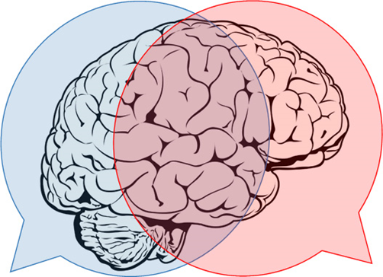
Introduction: neurolinguistics
Faculty of Computer Science &
Center for Language and Brain
Department of
Software Engineering
Moscow
2023
Speech is one of the cognitive functions most crucial for a person’s life quality
Brain surgery often causes impairments to speech, unless effort is put into its preservation
Language mapping allows to locate speech-relevant sites and
avoid them during surgery:
During open brain surgery the patient is prompted to produce speech
while areas of their brain are temporarily disabled via electric current
Importantly:
conducted in the patient’s mother tongue
must be standardized but tailored for each specific patient
The first standardized intraoperative naming test in Russian language was developed at the Center for Language and Brain, HSE

Slide 5
Problem and solution research
Faculty of Computer Science &
Center for Language and Brain
Department of
Software Engineering
Moscow
2023
Issue: the current solution is carried out manually (using a power-point consisting of probe images, a voice recorder and a timer), which is inconvenient during surgery. Also, only available in Russian.
The existing procedure:
test type choice based on the surgery site
preoperative testing, to determine stable stimuli for the patient
checking the preoperative testing and assembling the intraoperative test task battery
Inputs and outputs:
stimuli for tests
test results - audio recordings of patient’s answers
Notes:
Ручное проведение:
тестирование - Power Point презентация;
необходимость использования дополнительных устройств (микрофон);
организация базы данных пациентов
=> неудобство в операционной, в обработке результатов

Slide 6
Proposed solution
Faculty of Computer Science &
Center for Language and Brain
Department of
Software Engineering
Moscow
2023
Mobile application (currently for Android platform, but designed to be multiplatform) that will allow to:
create patient’s profile, input personal data
choose languages and tests for the patient
for each test
carry out preoperative stage
check preoperative stage
carry out intraoperative stage
store all the data in the procedure, including the recordings of the patient’s answers
import and export gathered data in accessible for researchers format
add new language testing batteries easily

Slide 7
Goals and methodology
Faculty of Computer Science &
Center for Language and Brain
Department of
Software Engineering
Moscow
2023
Goal:
Development of an Android mobile application for intraoperative language mapping procedure using naming tests in multiple languages
Milestones:
subject area analysis, study of the procedure
development of the requirements for the application
choice of the initial technology and methodology
workload planning
implementation of the application’s baseline
implementation of the minimal viable product
implementation of the fully-functional product version
testing and correction
documentation development
incorporation of the application into the customer’s infrastructure

Slide 8


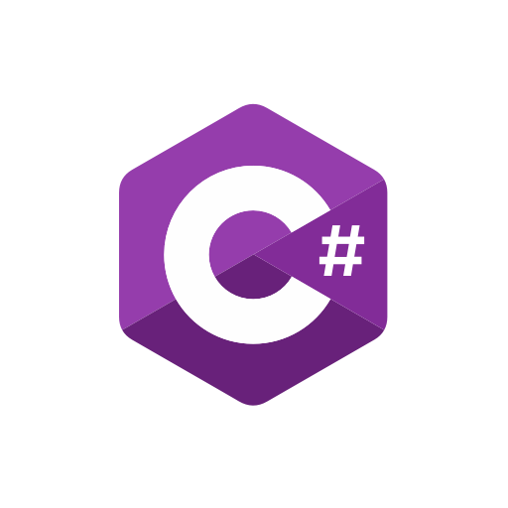


Technological stack
Faculty of Computer Science &
Center for Language and Brain
Department of
Software Engineering
Moscow
2023
Xamarin platform for portability
Xamarin Forms & C# & XML for the mobile application interface
SimpleAudioPlayer & AudioRecorder - plugins for multimedia processing
RESX resource incorporation
Visual Studio IDE
GitHub for version control
Kaiten for task management

Slide 9
Current stage
Faculty of Computer Science &
Center for Language and Brain
Department of
Software Engineering
Moscow
2023
requirements gathered and analyzed, design of the system developed
minimal viable product version implemented:
input of patient’s information
adding tests in different languages and navigating between their stages
preoperative test showing & checking
intraoperative test showing
recording and storing all the necessary data
storage of the standardized stimuli in easily expandable format
To be added:
pausing the tests
importing & exporting patients’ data in the .csv format

Slide 10
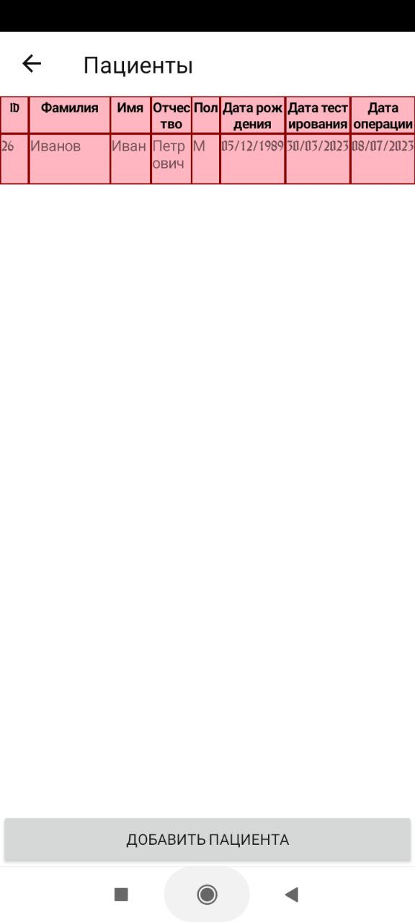
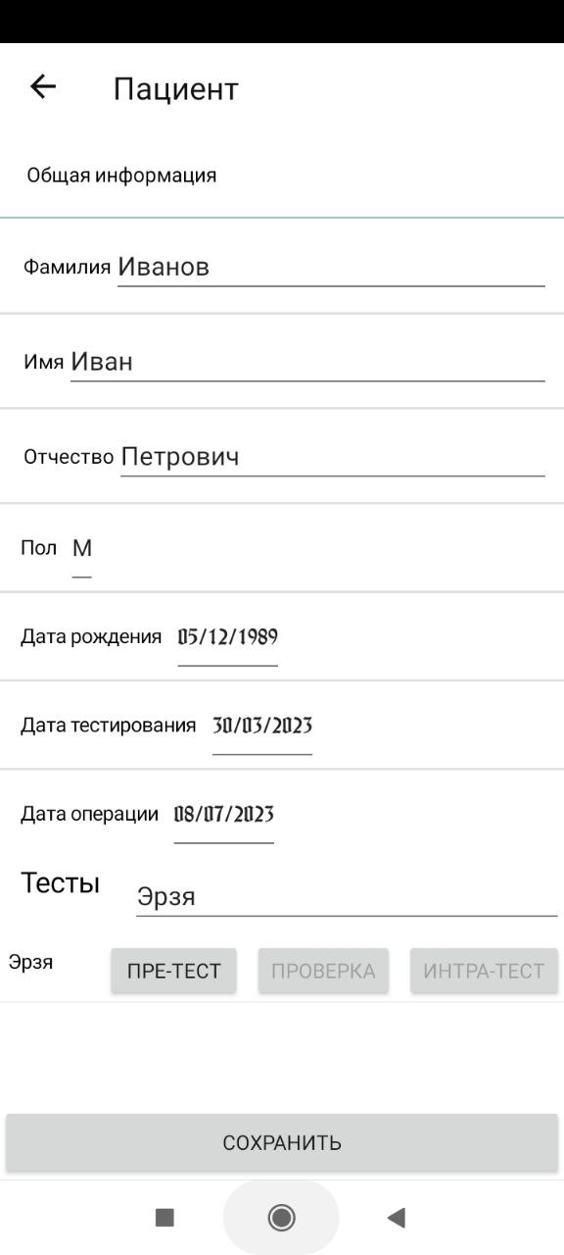
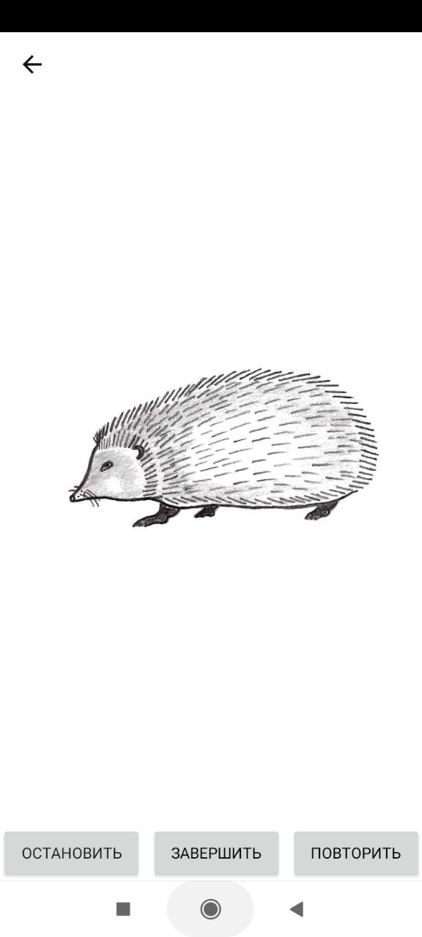
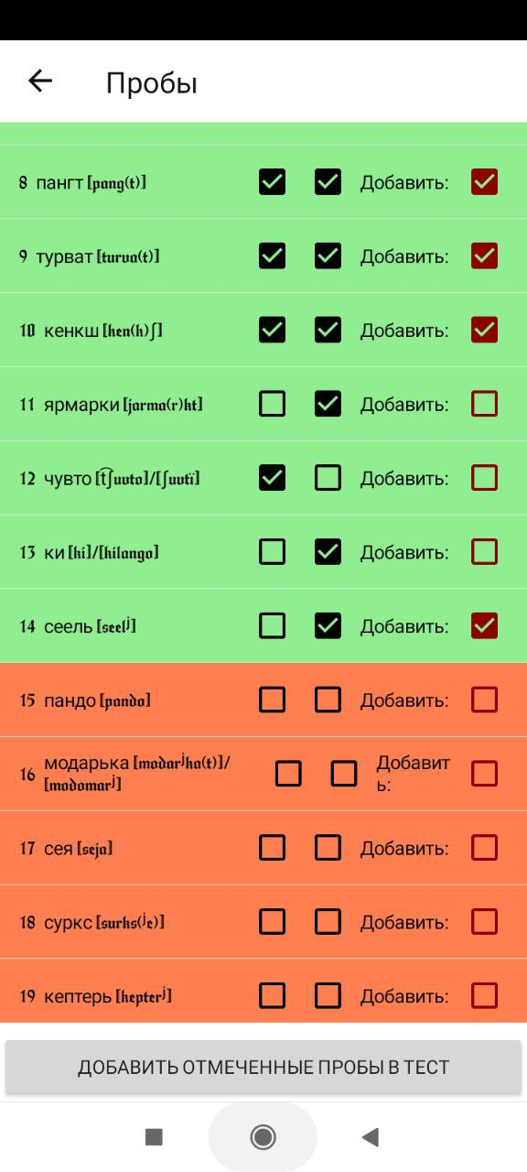
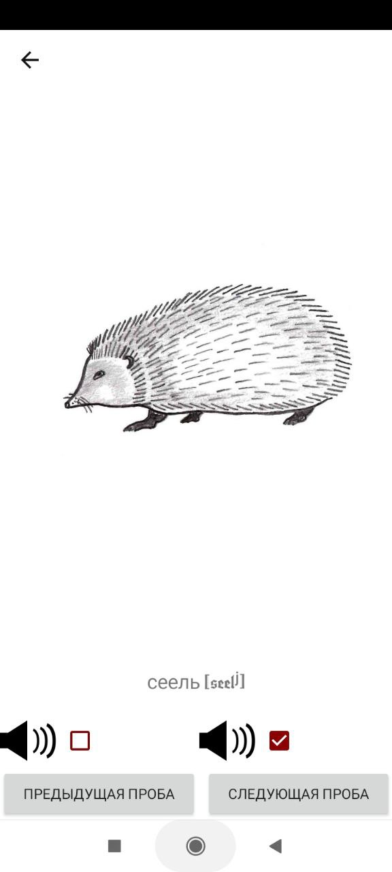
Current stage
Faculty of Computer Science &
Center for Language and Brain
Department of
Software Engineering
Moscow
2023

Slide 11
Expected results and conclusion
Faculty of Computer Science &
Center for Language and Brain
Department of
Software Engineering
Moscow
2023
Expected product:
Application that allows to perform the actions of language mapping procedure in multiple languages and stores results and other data in accessible format
Practical impact:
automation of the currently tedious process of language mapping
encouragement for other agents to develop their own software and collaborate
consequent higher efficiency of the procedure
additional languages available making the procedure suitable for their native speakers
improved life quality of the patients
Potential scientific impact:
The newly stored data, including that in the newly added languages, can be processed by neurolinguists and neuroscientists, which can lead to further discoveries.

Slide 12
References: academic
Faculty of Computer Science &
Center for Language and Brain
Department of
Software Engineering
Moscow
2023
Dragoy, O., Chrabaszcz, A., Tolkacheva, V., & Buklina, S.. (2016). Russian Intraoperative Naming Test: a Standardized Tool to Map Noun and Verb Production during Awake Neurosurgeries. The Russian Journal of Cognitive Science. 3. 4-26. 10.47010/16.4.1.
De Witte, E., Satoer, D., Robert, E., Colle, H., Verheyen, S., VischBrink, E., & Mariën, P. (2015). The Dutch Linguistic Intraoperative Protocol: A valid linguistic approach to awake brain surgery. Brain and Language, 140, 35–48. doi:10.1016/j. bandl.2014.10.011
«Surgery Needs to Preserve Brain Tumour Patients' Speech in Native Language» // HSE University URL: https://www.hse.ru/en/news/science/205306446.html (retrieval date: 10.03.2023).
Language test for speech mapping in neurosurgery // HSE University URL: https://www.hse.ru/en/neuroling/research/neurosurgery (retrieval date: 10.03.2023).

Slide 13
References: technical
Faculty of Computer Science &
Center for Language and Brain
Department of
Software Engineering
Moscow
2023
Adding Sound to a Xamarin.Forms App // Microsoft URL: https://devblogs.microsoft.com/xamarin/adding-sound-xamarin-forms-app/ (retrieval date: 10.03.2023).
Cross-platform with Xamarin // Microsoft URL: https://dotnet.microsoft.com/en-us/apps/xamarin/cross-platform (retrieval date: 10.03.2023).
Images in Xamarin.Forms // Microsoft URL: https://learn.microsoft.com/en-us/xamarin/xamarin-forms/user-interface/images?tabs=windows (retrieval date: 10.03.2023).
Kaiten // Kaiten URL: https://kaiten.ru/ (retrieval date: 10.02.2023).
MVC Design Pattern // GeeksForGeeks URL: https://www.geeksforgeeks.org/mvc-design-pattern/ (retrieval date: 10.02.2023).

Slide 14
Thank you for your attention!
Q&A
Faculty of Computer Science &
Center for Language and Brain
Department of
Software Engineering
Moscow
2023
Zubareva Nataliia
BSE195

